Slide 1
Setting up & Configuring Oracle DB for ENOVIA
3DEXPERIENCE 2014X

Slide 2
The steps to connect an Oracle client to an Oracle server are:
Create a database instance/service
Configure the Listener (Listener.ora) which is a server side configuration
Configure the client (Tnsnames.ora) which is the client side configuration
Test the connection

Slide 3
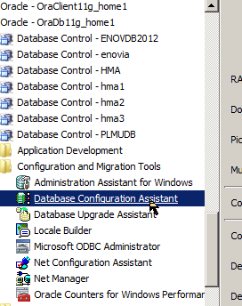
Creating an Oracle DB Instance
ENOVIA Server
Launch the Database Configuration Assistant to create a db instance Hover your mouse over it to note the path at which this tool is installed in your oracle server path
The oracle server also encompasses the oracle client installation
So if ENOVIA is accessed from the same machine where the server installation exists, the oracle server installation suffices
While, in the other scenario wherein ENOVIA is being accessed from a different (client) machine, an Oracle Client installation is required The figure shows the Oracle Client installation as well, immediately above the Oracle server, but in our case this is redundant
Oracle DB ENOVDB2012 (db Instance)

Slide 4
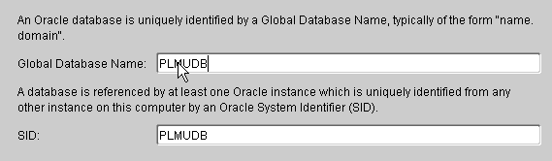
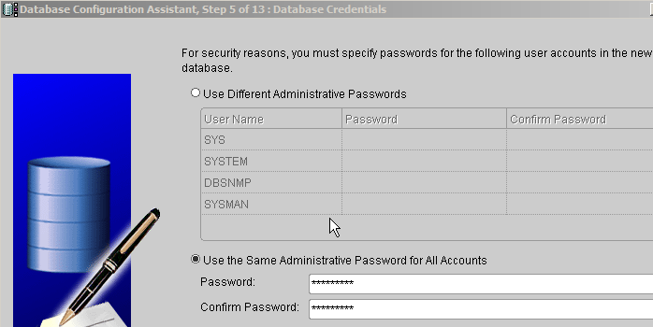
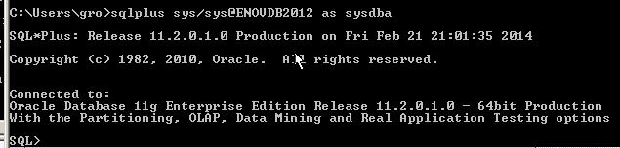
Creating an Oracle DB Instance
The db instance name is specified When creating a database with 'Oracle Database Configuration Assistant' (DBCA) specify a new, unique global_name. Many small and medium sized companies do everything under a single domain name, in which case these global names may seem like unnecessary work but if you do end up managing multiple domains at some point in the future (e.g. if your company is merged with another company) then having global names in place will make things much easier to manage.
To change the Global_Name of an existing database:
ALTER DATABASE rename global_name to demo.example.com;
By default, 4 oracle users are created We choose to give the same password to all namely. 3Dplm123#. It solves all criteria
SYS is oracle super user. Never use it for any other purpose
SYS, being an oracle super user is a special user and hence in addition to the password we provided at the top, “SYS” also serves as a password. A significant point to note is that when the oracle database is accessed with SYS, it must essentially be accessed as sysdba
More on this later ….

Slide 5
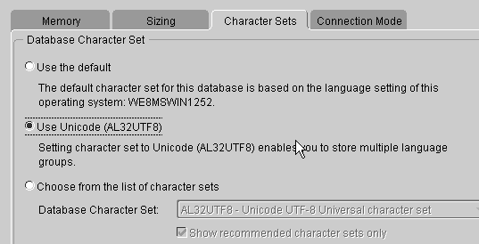
For Character Sets, choose Unicode
The Oracle database instance is successfully created. Note: At the time of creation of the db instance, it does fail if a listener for this db instance is not existing
We proceed to configure a listener
Watch out for this path: C:\Ora11gsrv\product\11.2.0\dbhome_1\NETWORK\ADMIN

Slide 6
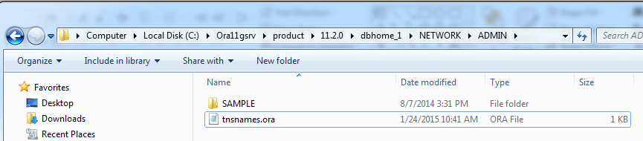
tnsnames.ora file is auto generated
More on this later …

Slide 7


Server side – listener.ora
The listener is a separate process that runs on the database server computer. It receives incoming client connection requests and manages the traffic of these requests to our database instance we created in the earlier step.
Ever gone to a grocery or a fruit store?
The shelves there is our DB Instance, the fruits are the entities user creates for storing in the db, and the man out there, providing the service is the Listener.
Server machine
Oracle DB ENOVDB2012 (db Instance)
Listener.ora

Slide 8
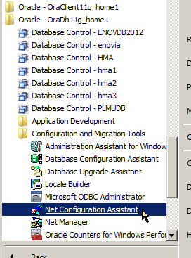
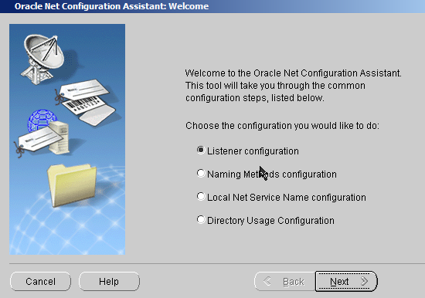
Configuring Listener using the Net Configuration Assistant

Slide 9
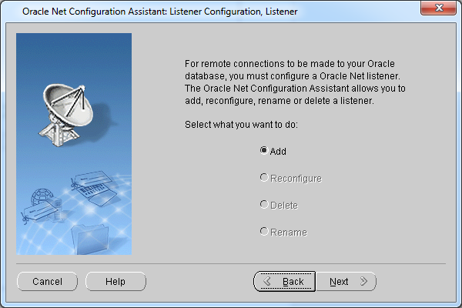
Configuring Listener using the Net Configuration Assistant

Slide 10
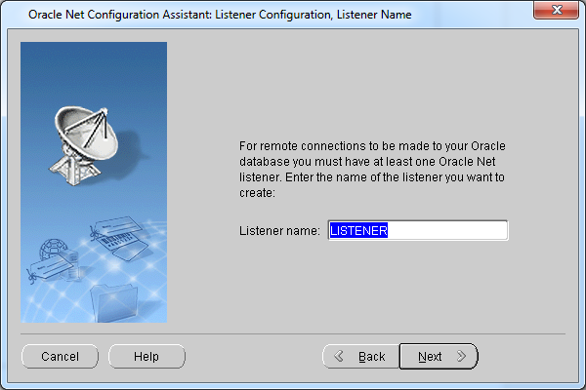
Configuring Listener using the Net Configuration Assistant

Slide 11
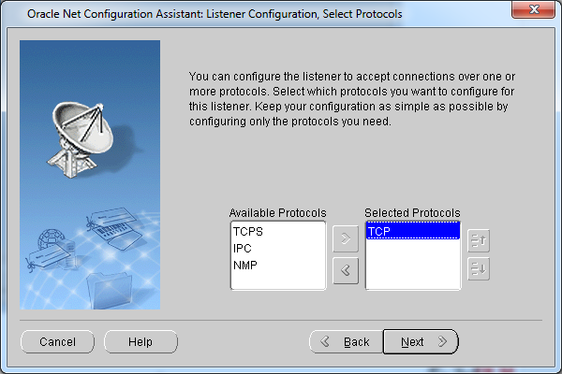
Configuring Listener using the Net Configuration Assistant

Slide 12
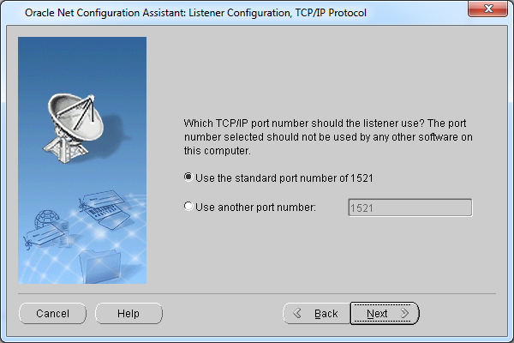
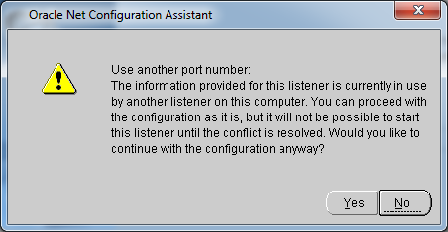
Configuring Listener using the Net Configuration Assistant
Specify the default port
If already in use, the port number is incremented by one

Slide 13
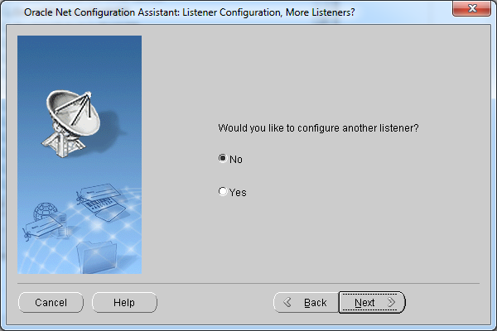
Configuring Listener using the Net Configuration Assistant

Slide 14
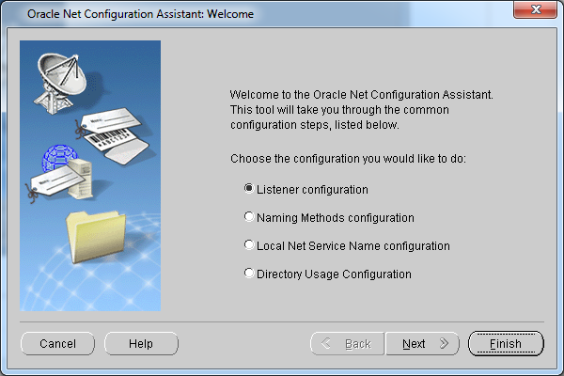
Configuring Listener using the Net Configuration Assistant
Click on Finish The LISTENER is thus added. It is so far not associated with any db service

Slide 15
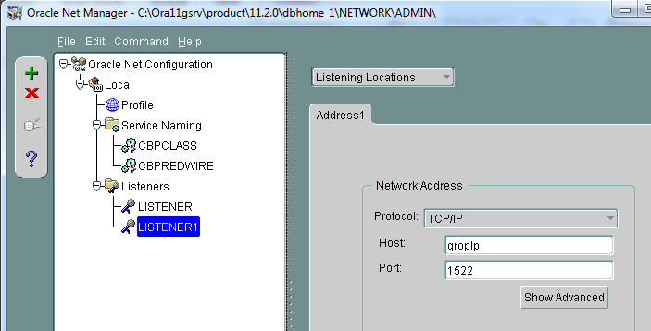
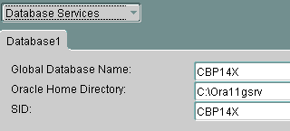
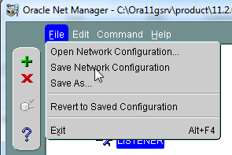
Associating Listener to a db service using Net Manager
Listener is hosted on groplp (server machine)
It listens at the port 1522 Another key input is the db service it caters to, which in this case is CBP14X
Next save the configuration It results in a listener.ora file at the location C:\Ora11gsrv\product\11.2.0\dbhome_1\NETWORK\ADMIN

Slide 16
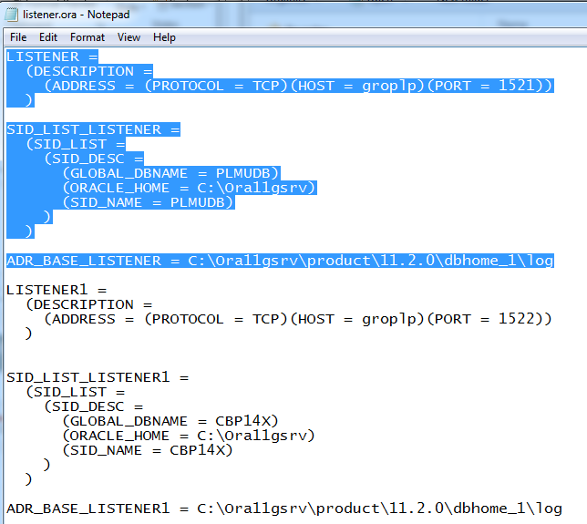
Associating Listener to a db service using Net Manager
listener.ora is now updated with the info
Which server is it hosted on?
What port it listens to?
Which db service does it point to?

Slide 17
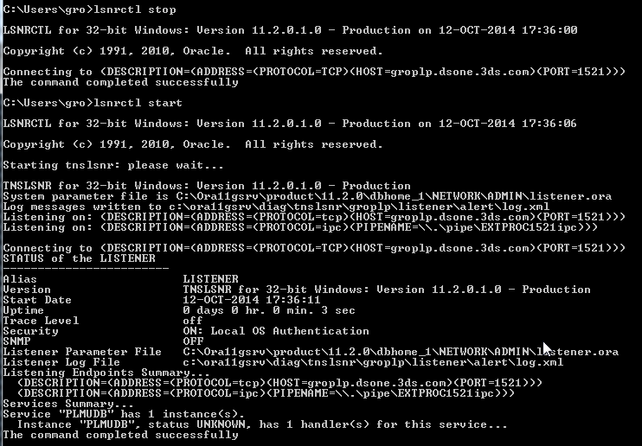
Stopping & Starting the Listener

Slide 18
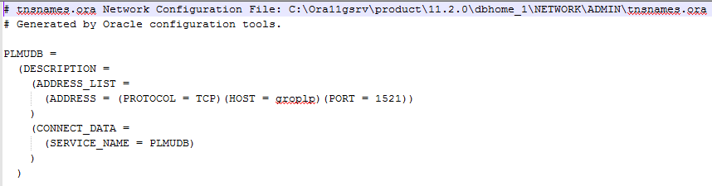
Oracle Client side - tnsnames.ora
Server machine
The TNSNAMES.ORA file is a client side network configuration parameters (typically on a remote PC). The client uses the TNSNAMES.ORA file to obtain connection details for the desired database. (Of course often you will want to install client software on the server as well for testing with SQL*Plus etc but that is optional.)
If your oracle client is in the same machine, as your oracle server, your oracle server installation, itself will serve as your oracle client installation
As a result, ORACLE_HOME will be the same for both
````````` Client machine
Oracle DB ENOVDB2012 (db Instance)
Oracle client installation
tnsnames.ora
Listener.ora

Slide 19
tnsnames.ora
The tnsnames.ora file contains the information about the server where your database is present , the port number information , the database name , the protocol used (tcp etc )
If a user wants to connect to a database then the software program which the user is using will look in the tnsnames.ora file and find out all the information what we discussed before. Then the software program uses this information and makes a connection to the database with the help of the listener
So important point is if a user want to connect to a database he or she would definetly need a tnsnames.ora file
What happens if 100 users want to connect to the database? Do we need 100 tnsnames.ora files? If the users are using a software program that is located on their machine then each user will need his own tnsnames.ora file. If the users are connecting to a website for example www.google.com then the user do not need to have a tnsnames.ora on his machine because the website is located on a webserver so the tnsnames.ora file would already be in the webserver.
Some java programs do not need a tnsnames.ora file .What they do is ,they can read all this information from a different file which they created . The java developers speak to the dba and will get the database information. Then they store this information in a different file. Then the java program reads this file and will connect to the database.
Notes:
http://journeyoracle.blogspot.in/2012/07/what-are-listenerora-tnsnamesora.html

Slide 20
sqlnet.ora
If a tnsnames.ora file has to work properly , then we need the sqlnet.ora file. The sqlnet.ora file contains some information which the user process(the user connection) needs ,to find exactly where a database server is located
So the user process normally reads the tnsnames.ora file and then the sqlnet.ora file and thus will find the complete database server information, database name etc and will talk to the listener which is present on the database server
The listener will then will see that a conenction is opened to the database
There are also lot of other parameters in the sqlnet.ora file that you can use
This file contains optional client-side network diagnostic parameters
Notes:
http://journeyoracle.blogspot.in/2012/07/what-are-listenerora-tnsnamesora.html

Slide 21
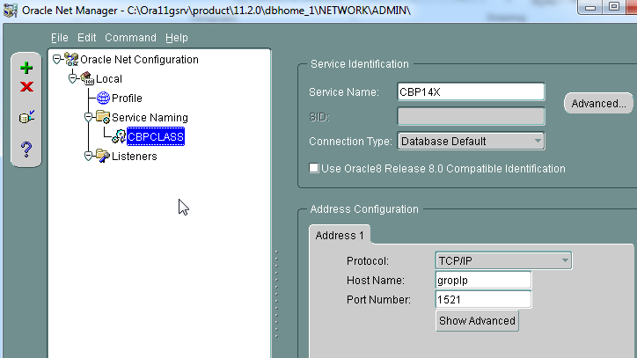
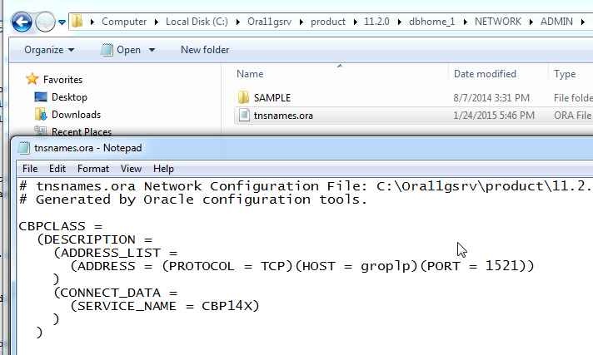
Client side access to db – tnsnames.ora using Net Manager
On the client side, you run the Net Manager tool and add a service CBPCLASS, for instance
This could be any service name, that you wish to give on the client side
Then you provide the name of the actual db service on the server side which is CBP14X
The tnsnames.ora file generated will thus have CBPCLASS pointing to CBP14X on the server
You can test connection to this db service, independent of the Listener

Slide 22
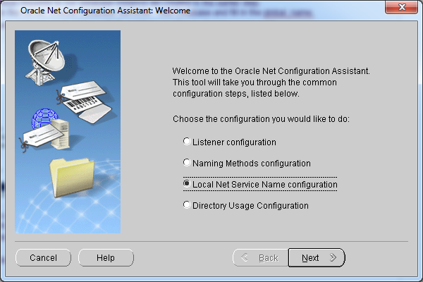
Generating the client side tnsnames.ora file using Net Configuration Assistant
This is for exclusively generating the tnsnames.ora which otherwise, by default, is generated at the time of db instance creation
This generates both tnsnames.ora and sqlnet.ora file

Slide 23
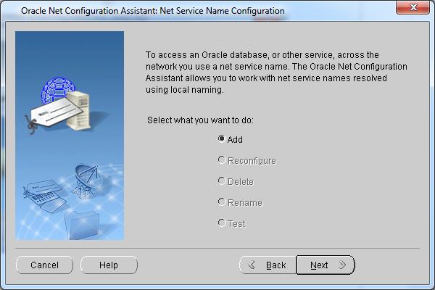
Generating the client side tnsnames.ora file using Net Configuration Assistant

Slide 24
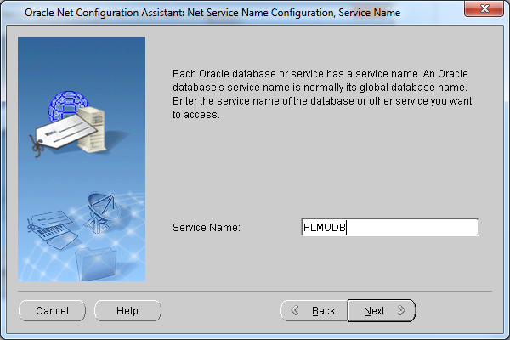
Generating the client side tnsnames.ora file using Net Configuration Assistant
You don’t have an option here of providing an alias service name of your choice and mapping it to the real db service

Slide 25
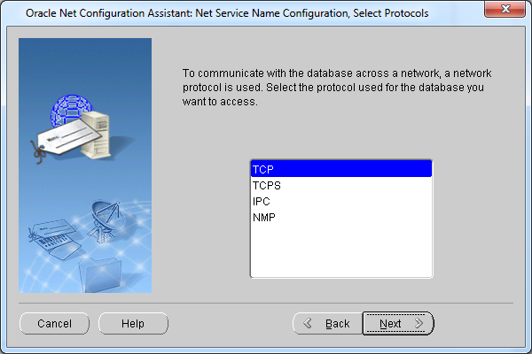
Generating the client side tnsnames.ora file using Net Configuration Assistant

Slide 26
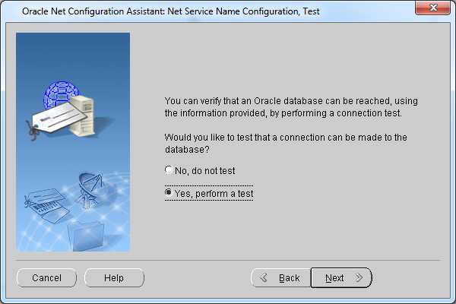
Generating the client side tnsnames.ora file using Net Configuration Assistant
Note: You can still perform a test, independent of the Listener.

Slide 27
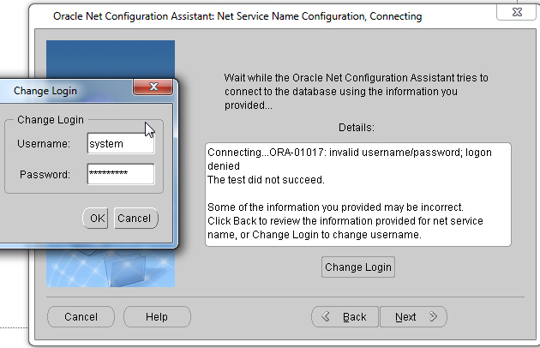
Generating the client side tnsnames.ora file using Net Configuration Assistant
By default the scott/tiger log in will not work. You need to change it to system.3Dplm123#

Slide 28
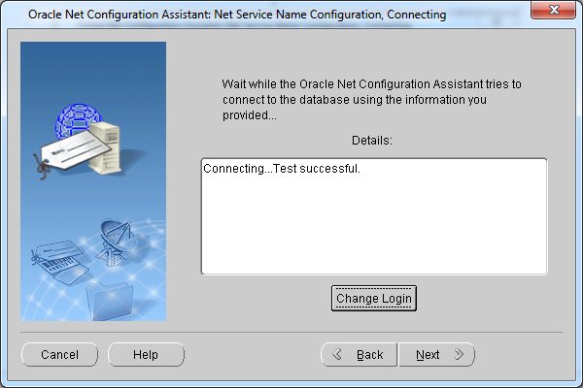
Generating the client side tnsnames.ora file using Net Configuration Assistant
This test is the client side connection which succeeds

Slide 29
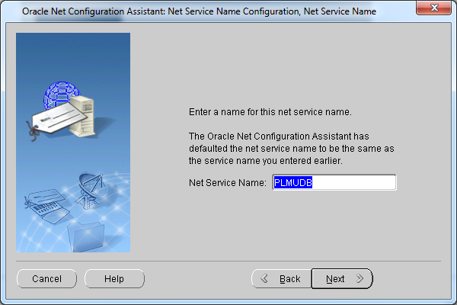
Generating the client side tnsnames.ora file using Net Configuration Assistant

Slide 30
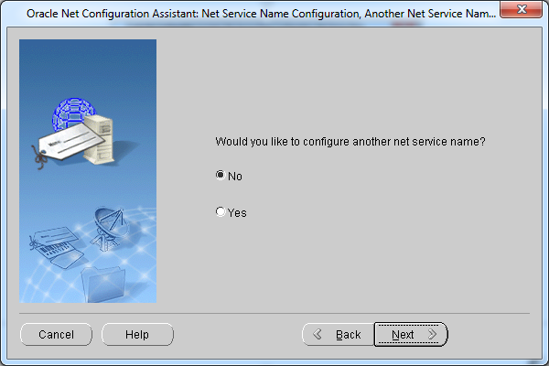
Generating the client side tnsnames.ora file using Net Configuration Assistant

Slide 31
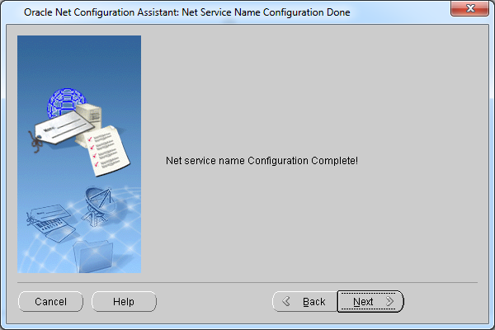
Generating the client side tnsnames.ora file using Net Configuration Assistant

Slide 32
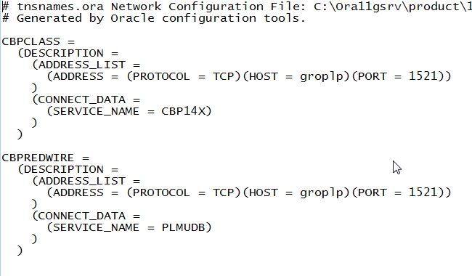
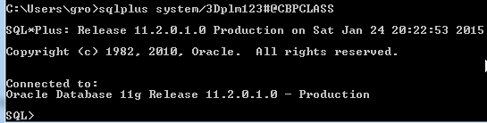
The tnsnames.ora client side file contents & connection using SQL prompt
It lists all the db services hosted on the server machines which client needs access to
Sqlplus system/3Dplm123#@CBPCLASS

Slide 33
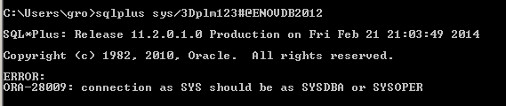
Testing the Oracle DB Connection (1/2)
Connecting to my oracle db instance using the Oracle super user sys credentials
Connecting to my oracle db instance using the Oracle super-user sys credentials but not as sysdba
Failure encountered since connection as sys should be as sysdba, necessarily

Slide 34
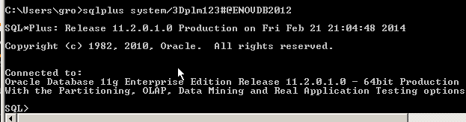
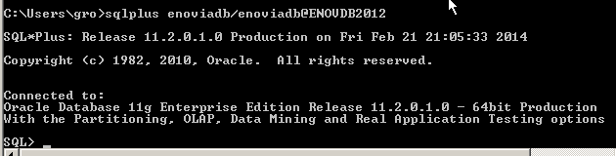
Testing the Oracle DB Connection (2/2)
Connecting to my oracle db instance as system (alternative oracle user, not super-user note)
Connecting to my oracle db instance as an enovia user (the one explicitly created for your BPS and other ENOVIA Centrals installation, in the steps that will follow)

Slide 35
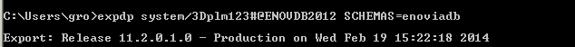
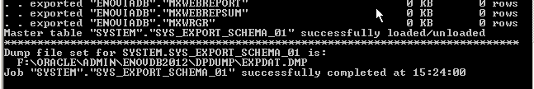
Backup ENOVIA DB – The expdp Command
expdp system/3Dplm123#@ENOVDB2012 SCHEMAS=enoviadb
ENOVDB2012 is the oracle db instance name
enoviadb is the enovia user

Slide 36
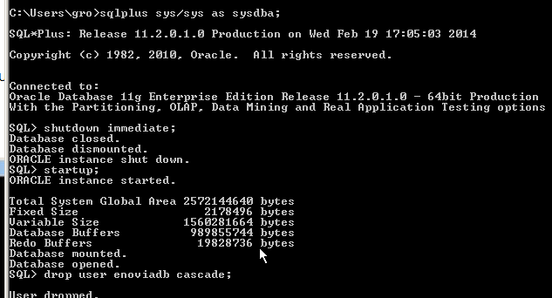
How to drop User?
Connect to your db as oracle superuser sys

Slide 37
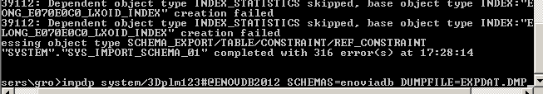
How to import ENOVIA Oracle db?

Slide 38
We are done with setting up & configuring the Oracle db
We next go ahead with the Installation of ENOVIA …

Slide 39
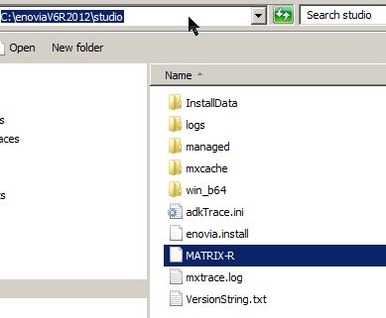
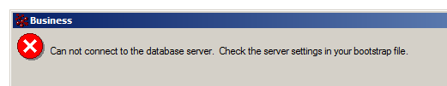
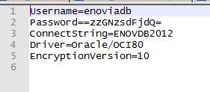
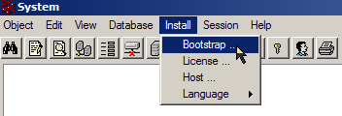
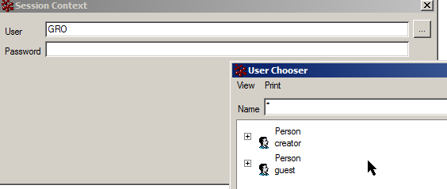
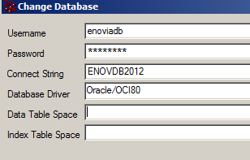
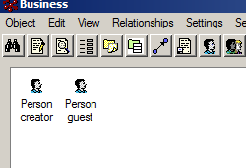

Slide 40
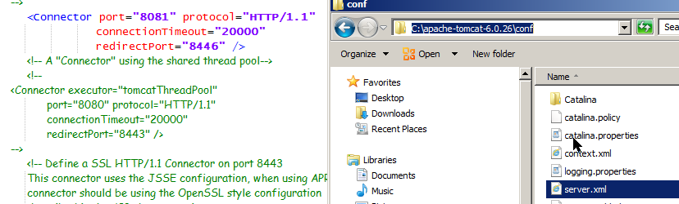
Server.xml in tomcat install folder has the port on which tomcat listens

